Slide 1
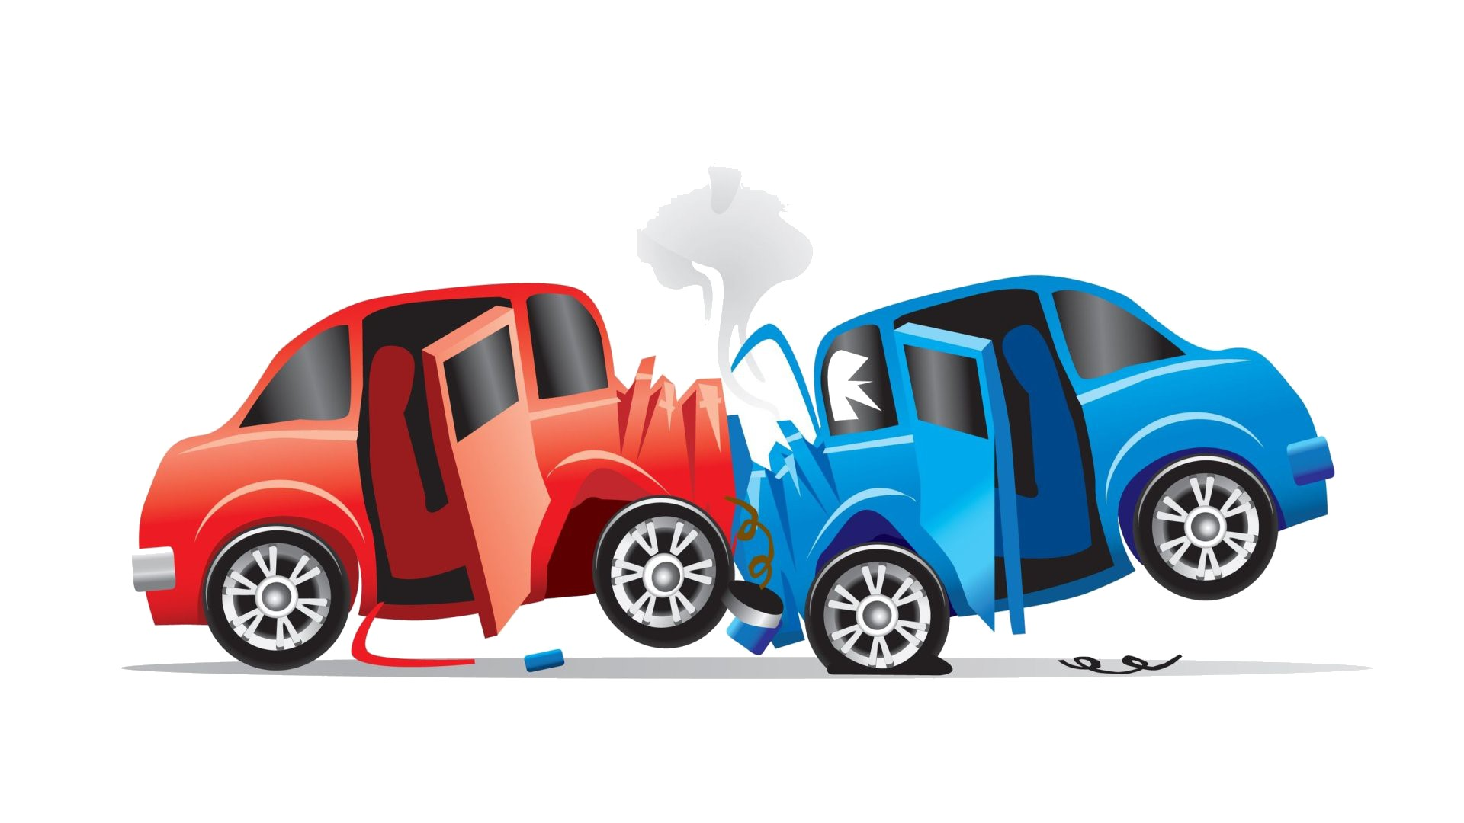
Car accidents analysis

Slide 2
Meet the Team
Team Leader & Data Analyst Data Modelling Data Engineers
Mary Prashanthi Vongala Sravya Kaitha Alekya Basike
Karthik Reddy Thumma

Slide 3
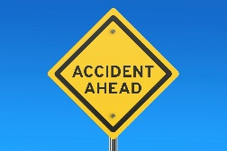
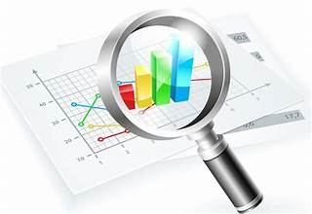
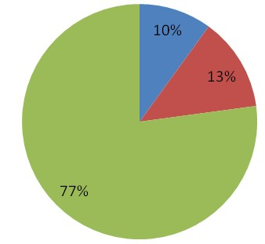
The Problem
Casualty analysis
Identifying Hotspot locations of car accidents
Studying the impact of precipitation/other environmental factors
3

Slide 4
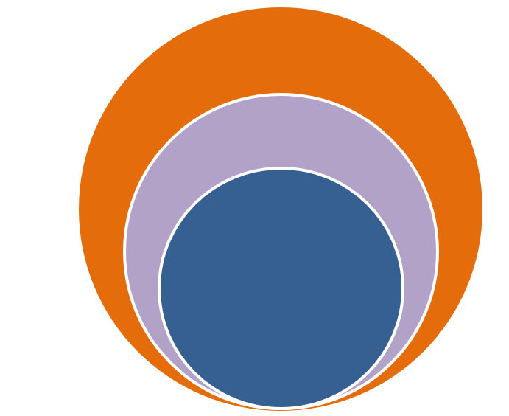
Statistics
2023
5.2M Car Accidents (Expected)
2022
4.8M Car Accidents as per reports
2021
4M Car accidents as per reports
5.2M
4.8M
4M

Slide 5
The Solution
We are gone calculate real-time car accident prediction, studying car accidents hotspot locations, casualty analysis and extracting cause and effect rules to predict car accidents.
Plot the graph between severity and weather, temperature and humidity to know the how the severity level depends on weather conditions.

Slide 6
CRISP-DM
Business understanding
Business Objective
Deploy the Application in AWS and Automate
Deployment
Data
Understanding
Data Exploration
Data
Evaluation
Data
Preparation
Evaluating the Metrics
Feature Engineering
Modeling
Predicting Potential customers using machine learning algorithms
University of New Haven

Slide 7

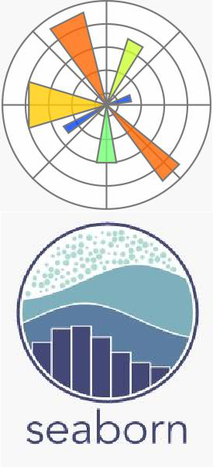






Graphical representation
University of New Haven

Slide 8
Data Understanding
Data comes from Open Data source and describes the history of car accidents that has happened in USA.
The dataset contains 7,728,394 rows and 45 columns, describing the severity of accident, location, reason for the accident and other factors.

Slide 9
Data Preparation
We have collected the data from open source and uploaded into git.
The data gathered from different sources by using various techniques is to be analyzed with data analyzing tools like Pandas, NumPy etc.
Analyzing/cleaning is to read the data which is gathered. During this process, the unwanted data is cleaned and made precise for the data visualization.
We also performed EDA (Exploratory Data Analysis) on the input data.

Slide 10
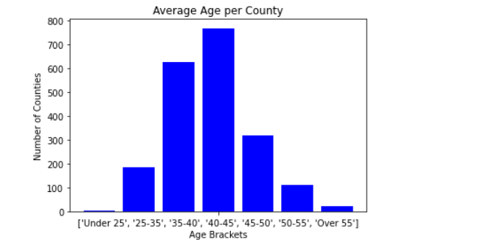
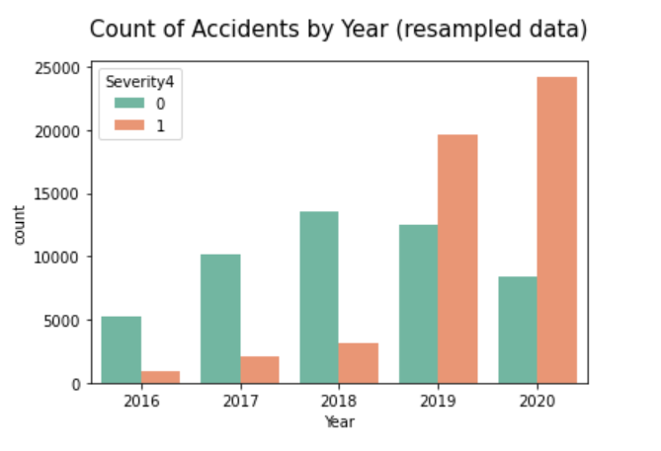
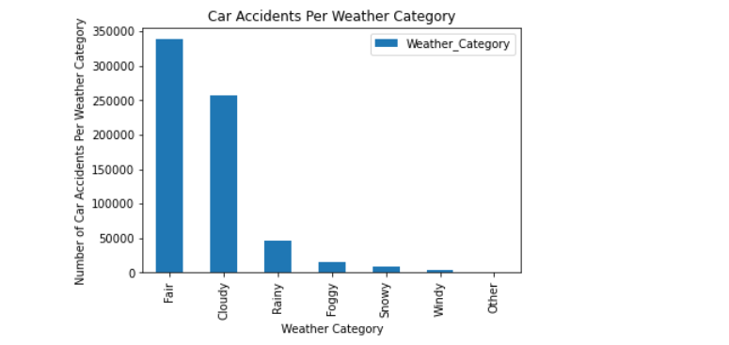
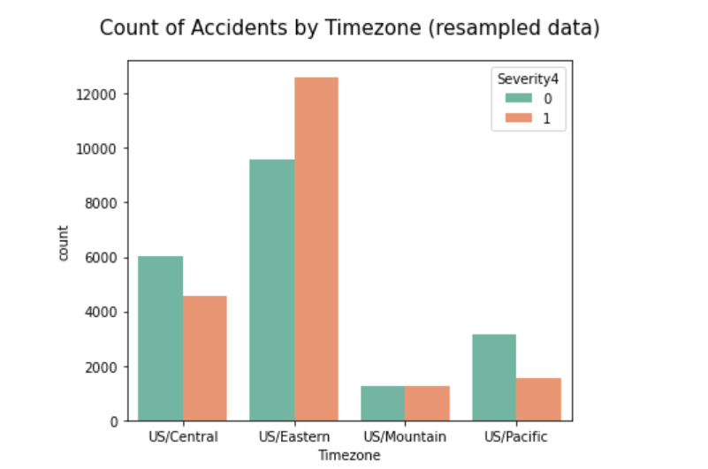
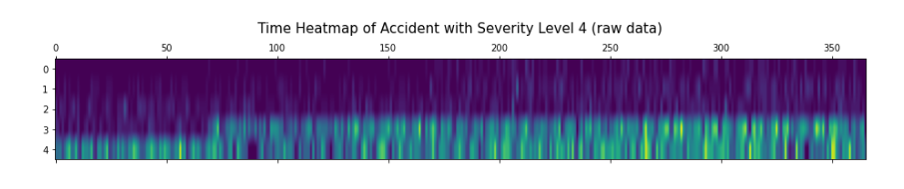
EDA
University of New Haven

Slide 11
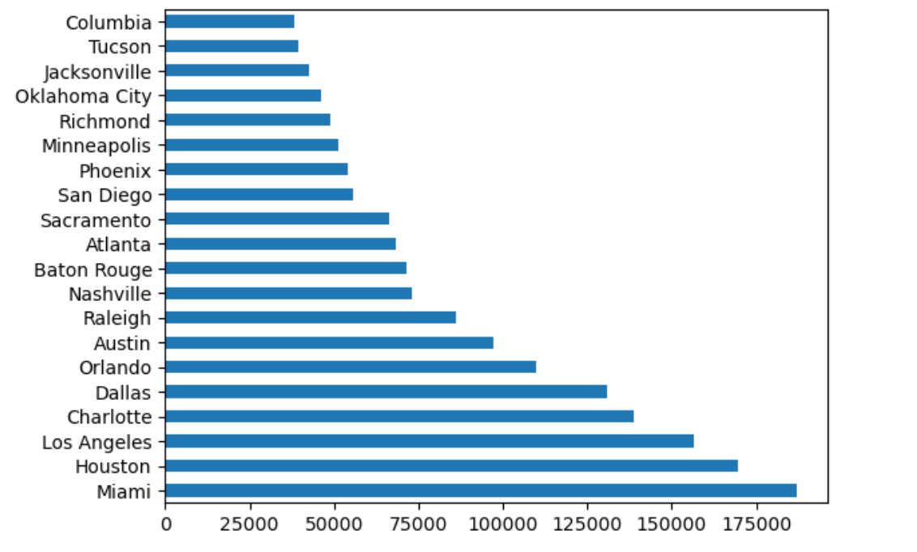
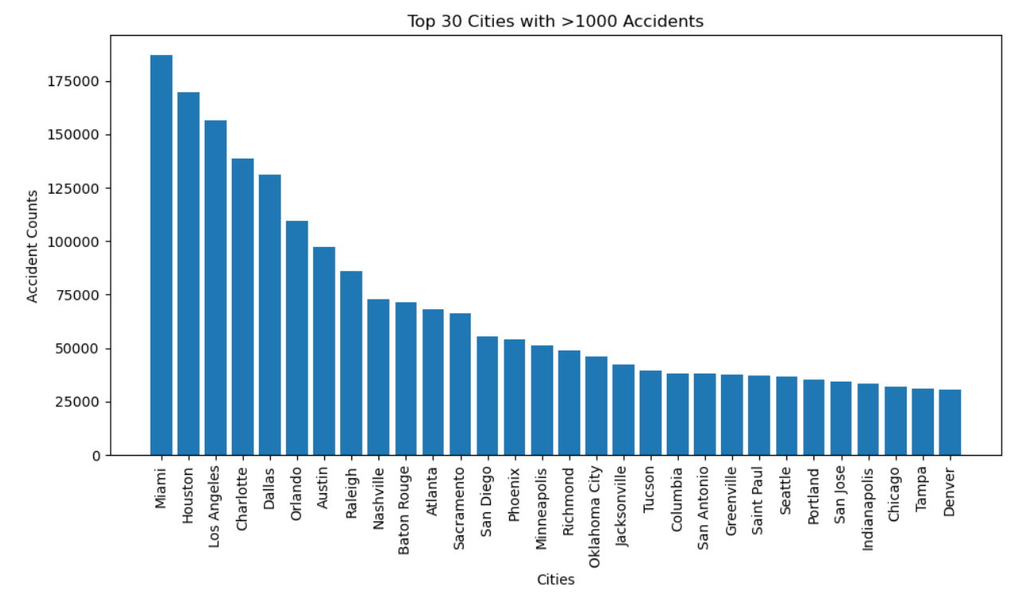
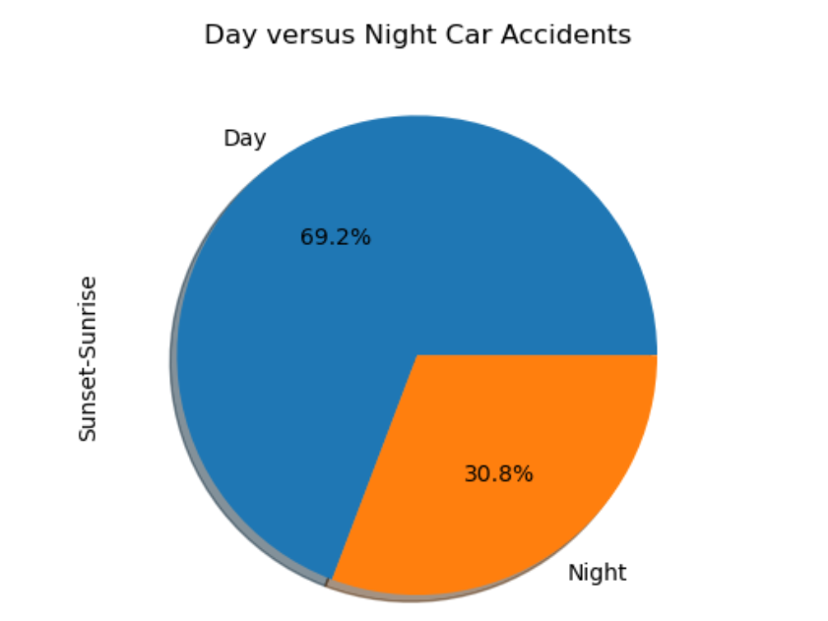
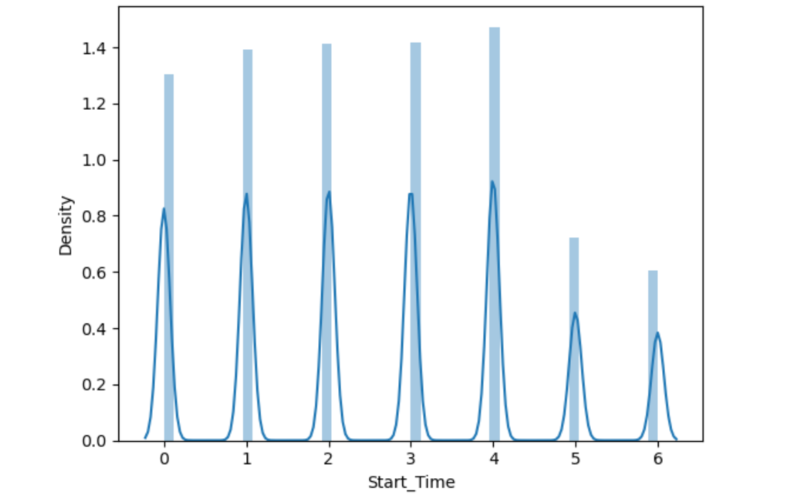
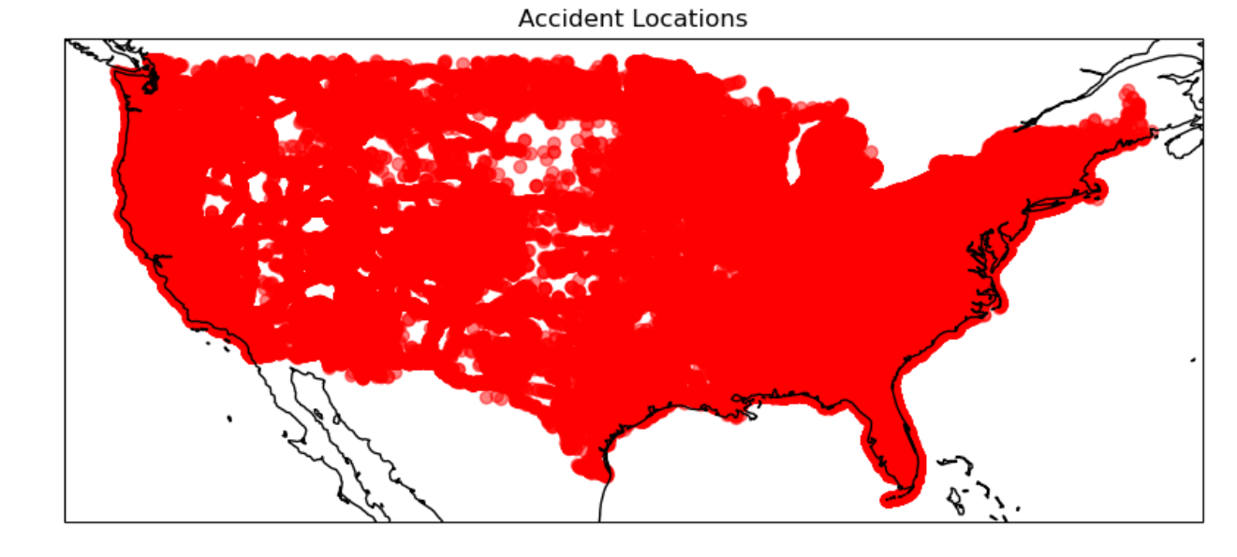
EDA
University of New Haven

Slide 12
Modelling & Evaluation
Build a Random forest , K-NN and Navies Bayes algorithm to decide the car accident's location.
The k-nearest neighbors’ algorithm, also known as KNN or k-NN, is a non-parametric, supervised learning classifier, which uses proximity to make classifications or predictions about the grouping of an individual data point
Used a Flask application to deploy the result reports.

Slide 13
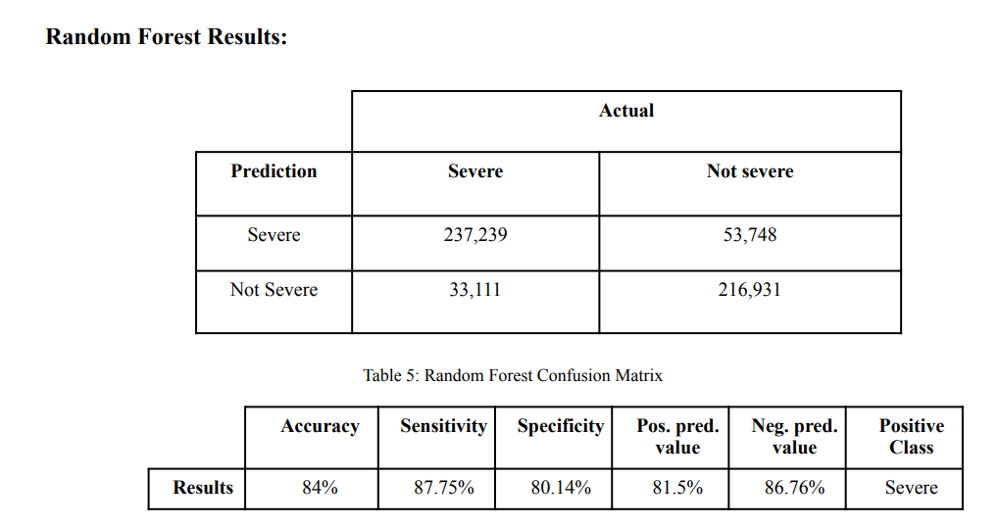

Slide 14
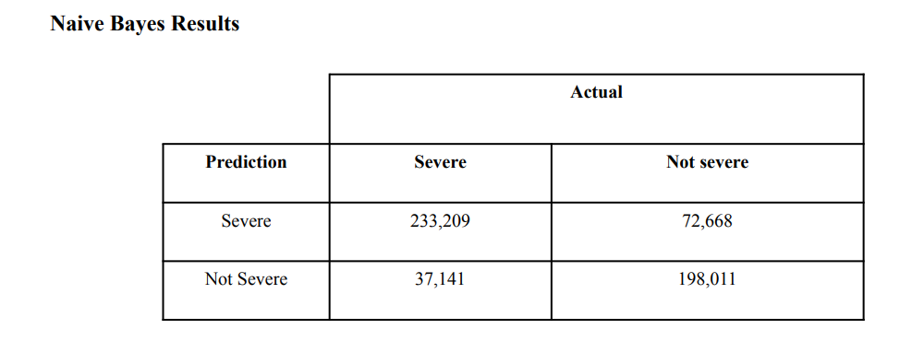

Slide 15

Deployment
University of New Haven

Slide 16
Thank You
University of New Haven

